Slide 1
Transit for Reshelving Rules and "no transit"
Yoel Kortick. Senior Librarian

Slide 2
Contents
Introduction | I
Behavior before we configure the new definitions | II
Configuring the new definitions | III
Behavior after we configure the new definitions | IV

Slide 3
Introduction
It is possible to set relation rules between libraries, departments and circulation desks in order that "transit for reshelving" will not be required between certain libraries.
This eliminates unnecessarily scanning in items between departments when items are not actually "transited".
This may occur for example when the libraries are close to each other. It may also occur for any other reason whereby two libraries decide that after retuning at the circulation desk of one library it should be considered already "in place" in the destination library without scanning it in again.

Slide 4
Introduction
The "Transit for reshelving" rules do not effect other transit types, such as hold shelf, work order, and processing.
The default rule has no input parameter. An output parameter is set to false to put all items into transit when reshelving.
Each rule can be either enabled or disabled. By default, each new rule is enabled.

Slide 5
Introduction
See also the On Line Help at https://knowledge.exlibrisgroup.com/Alma/Product_Documentation/010Alma_Online_Help_(English)/030Fulfillment/080Configuring_Fulfillment/020Library#Configuring_Reshelve_Without_Transit_Rules

Slide 6
Contents
Introduction | I
Behavior before we configure the new definitions | II
Configuring the new definitions | III
Behavior after we configure the new definitions | IV

Slide 7
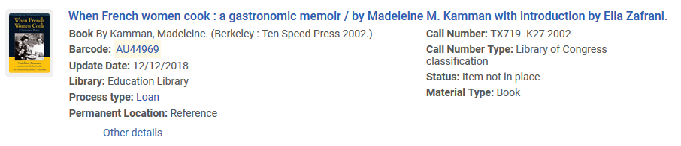
Behavior before we configure the new definitions
Item barcode AU44969 title "When French women cook : a gastronomic memoir / by Madeleine M. Kamman with introduction by Elia Zafrani" belongs to the Education Library

Slide 8
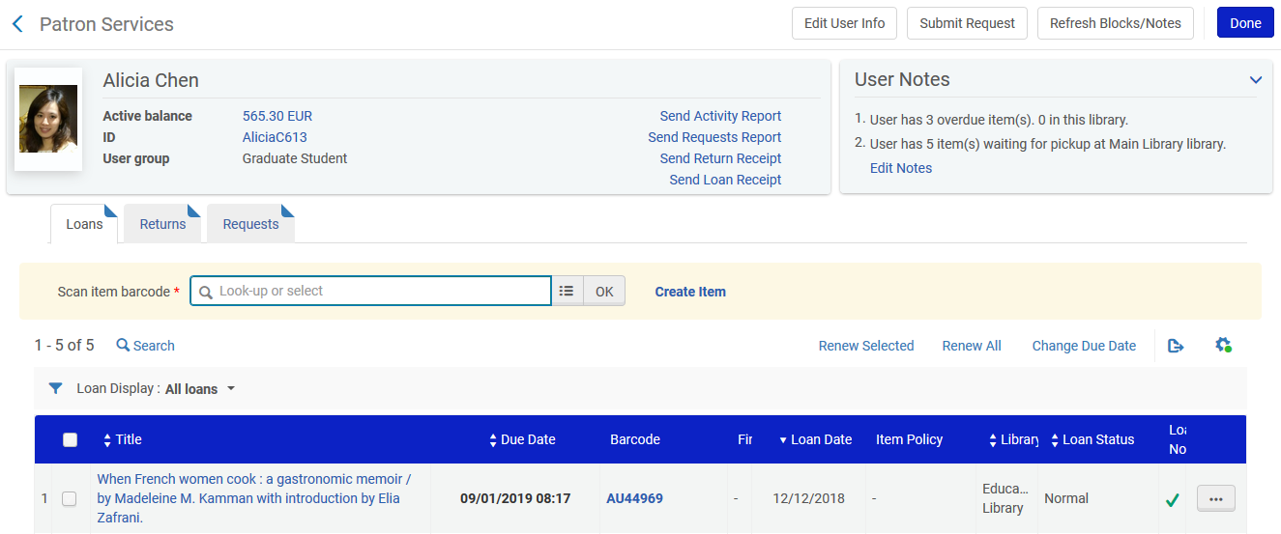
Behavior before we configure the new definitions
The item is currently on loan to Alicia Chen

Slide 9
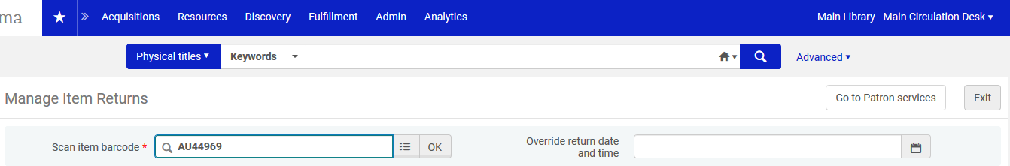
Behavior before we configure the new definitions
From the Main Library circulation desk the item from the Education Library is returned

Slide 10
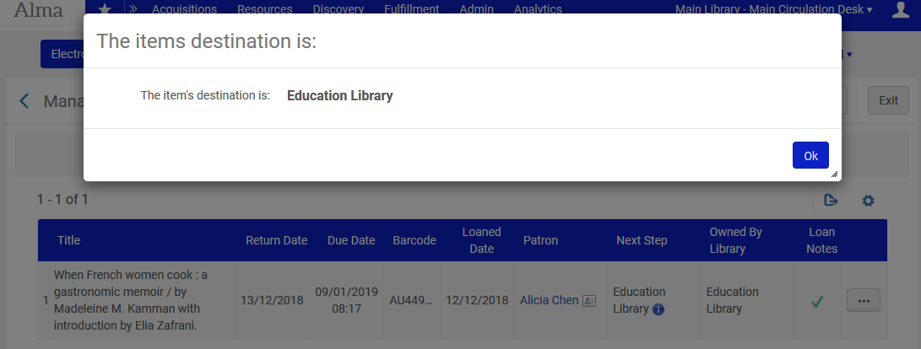
Behavior before we configure the new definitions
The item must be transferred to the Education Library

Slide 11
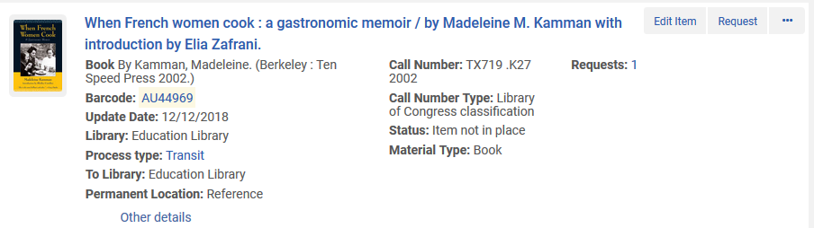
Behavior before we configure the new definitions
The item is in process type transit

Slide 12
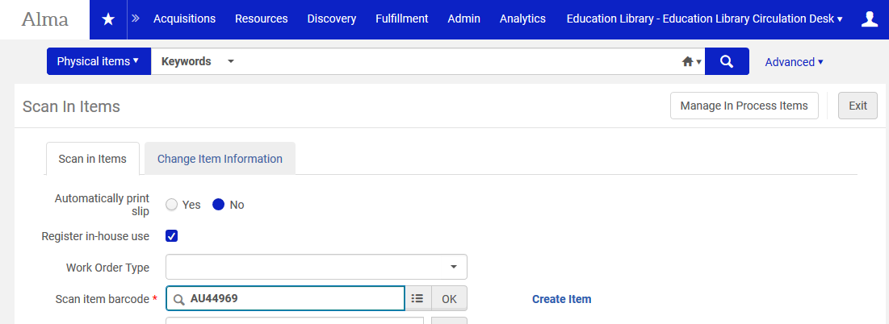
Behavior before we configure the new definitions
Later the item is scanned in at the Education Library

Slide 13
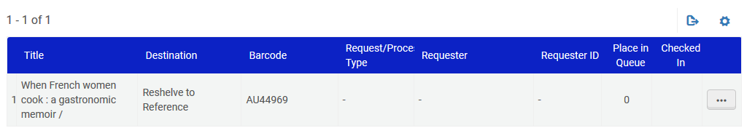
Behavior before we configure the new definitions
At the Education library the item needs to be reshelved to the "Reference" location

Slide 14
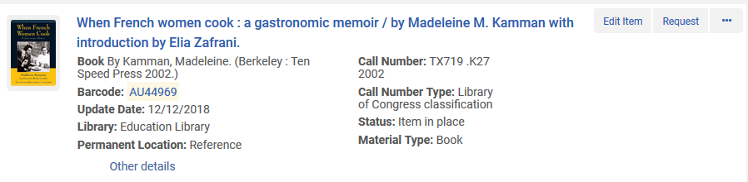
Behavior before we configure the new definitions
The item is no longer in process type "In Transit"

Slide 15
Contents
Introduction | I
Behavior before we configure the new definitions | II
Configuring the new definitions | III
Behavior after we configure the new definitions | IV

Slide 16
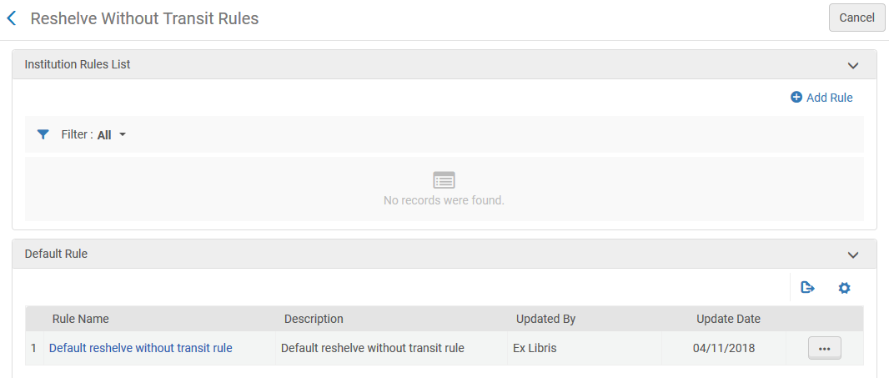
Configuring the new definitions
We will now configure "reshelve without transit" rules from the "Reshelve Without Transit Rules" page
This is accessible at configuration Menu > Fulfillment > Library Management > Reshelve Without Transit Rules.

Slide 17
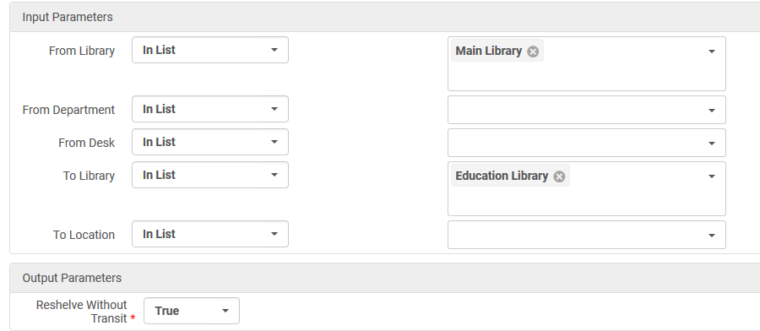
Configuring the new definitions
After clicking "Add rule" we have defined that any item going from the Main Library to the Education Library will be reshelved without transit.
Note that we could have been more specific and selected work order departments or circulation desks from the Main Library

Slide 18
Contents
Introduction | I
Behavior before we configure the new definitions | II
Configuring the new definitions | III
Behavior after we configure the new definitions | IV

Slide 19
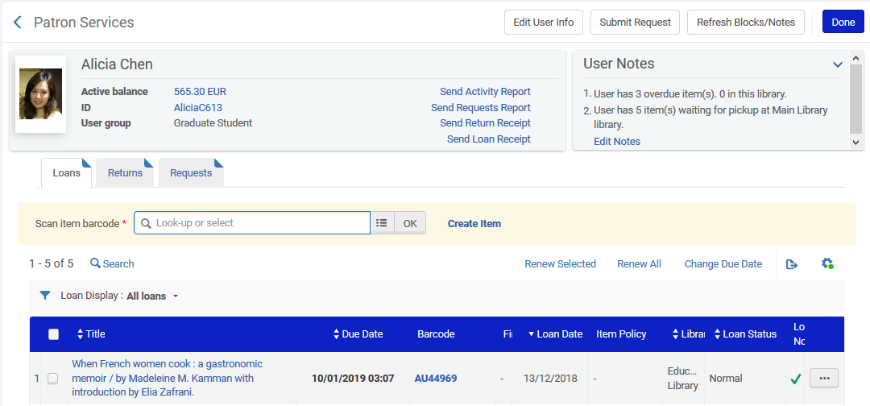
Behavior after we configure the new definitions
Again item barcode AU44969 is on loan to Alicia Chen

Slide 20
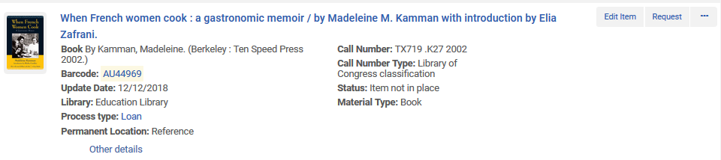
Behavior after we configure the new definitions
Here is the item in physical items search, barcode AU44969 is on loan to Alicia Chen

Slide 21
Behavior after we configure the new definitions
From the Main Library circulation desk the item from the Education Library is returned
Last time we did this we got a message "The item’s destination is: Education Library". Then the item went into transit, and then we had to scan it in again at the Education Library

Slide 22
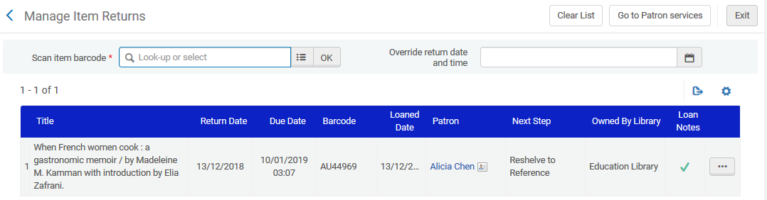
Behavior after we configure the new definitions
This time we did not get a message regarding the destination of the item.
We get an indication that it needs to be reshelved to the Reference Location and that the owning library is the Education Library

Slide 23
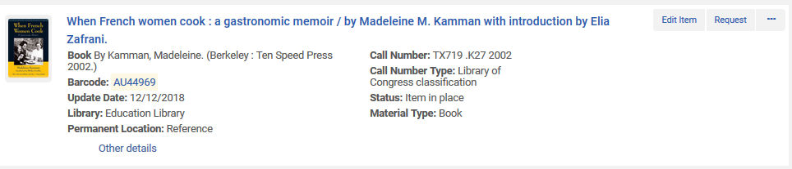
Behavior after we configure the new definitions
The item is considered "in place" with no need to scan it in again.

